Slide 1
BOLLYWOOD DREAMS
Visual Lookbook
A Musical Feature Film
Written by David S. Harris

Slide 2
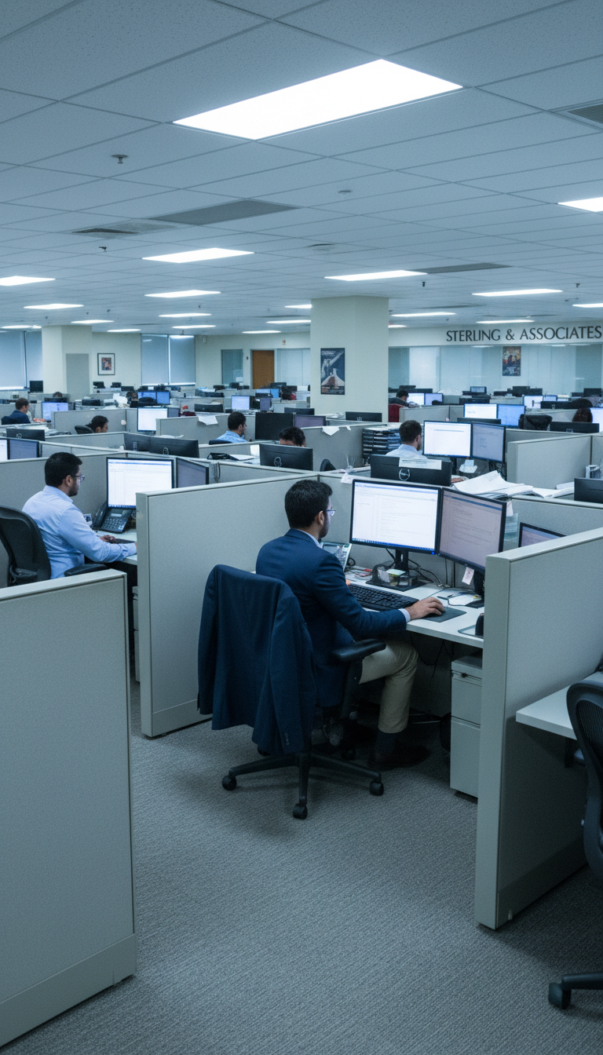
The Cage
Corporate cubicles, cold lights.

Slide 3
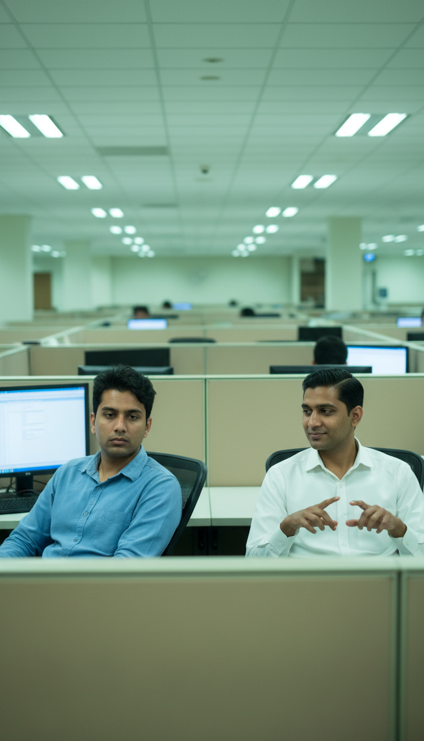
The Cage
Corporate cubicles, cold lights.

Slide 4

The Cage
Corporate cubicles, cold lights.

Slide 5
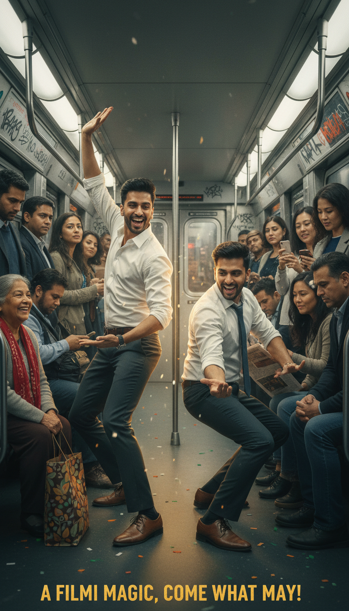
The Daily Commute
Subway car transforms into stage.

Slide 6
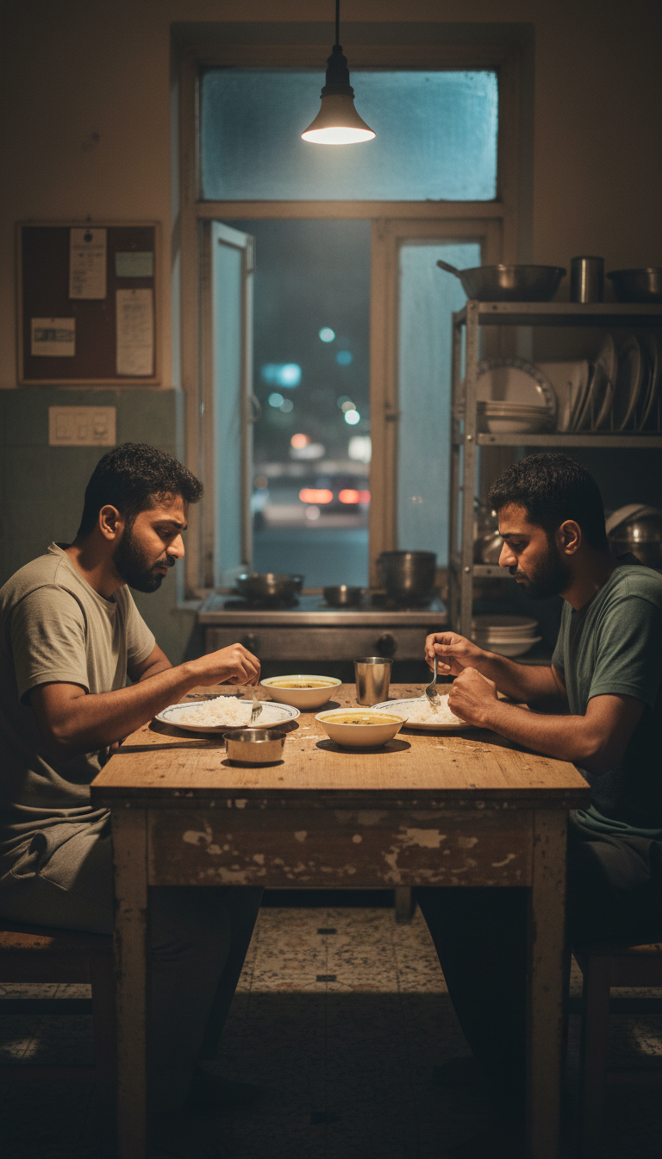
Late Night Dreaming
Dal and dreams. Two friends at table.

Slide 7
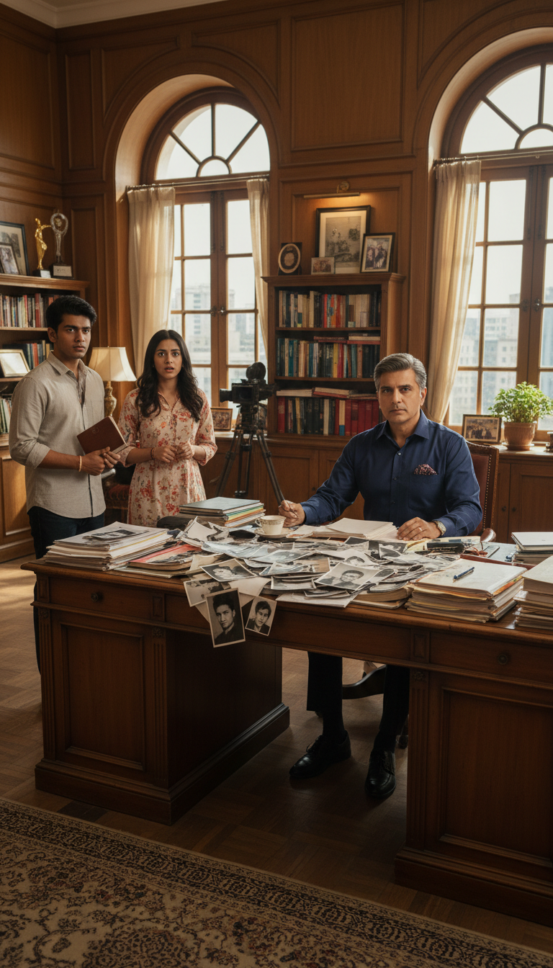
Late Night Planning
Queens apartment. Keyboard and posters.

Slide 8
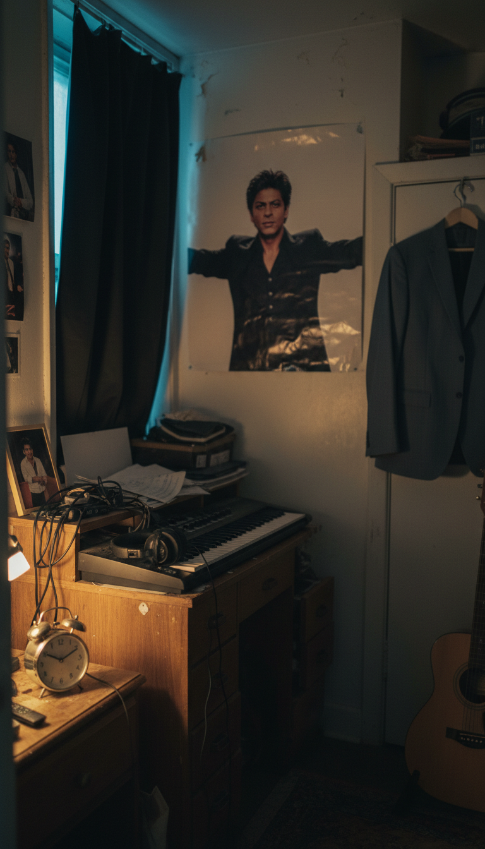
Late Night Planning
Queens apartment. Keyboard and posters.

Slide 9
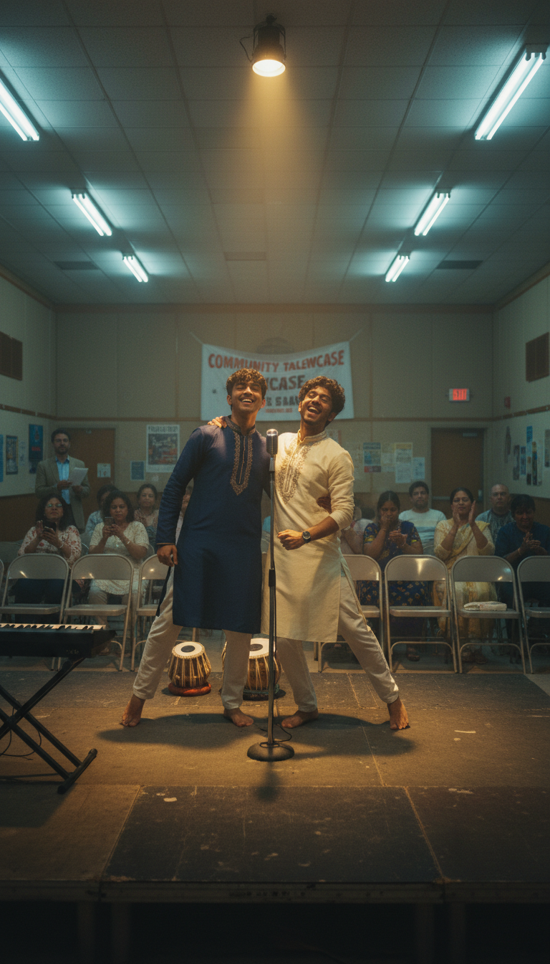
The First Public Performance
Community center. Where Manju discovers them.

Slide 10
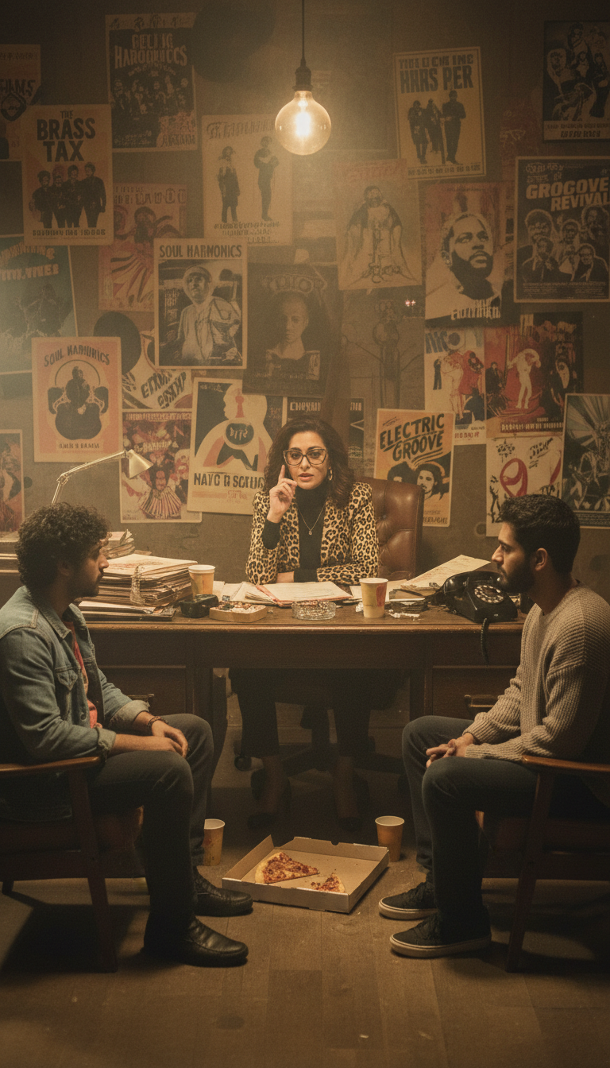
Meeting the Mentor
Manju's office—walls covered in music history.

Slide 11
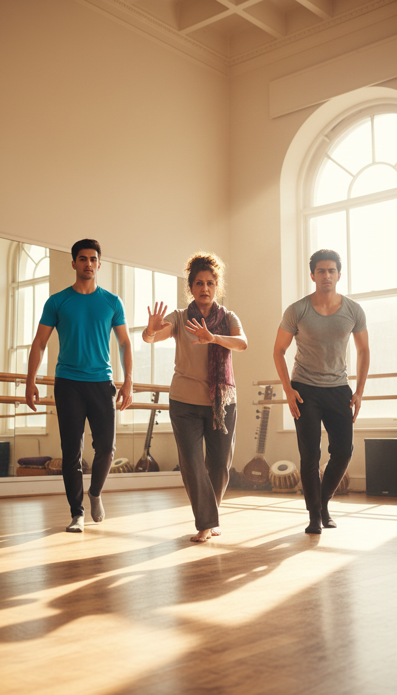
Learning the Craft
Golden hour rehearsals. Sweat and dedication.

Slide 12
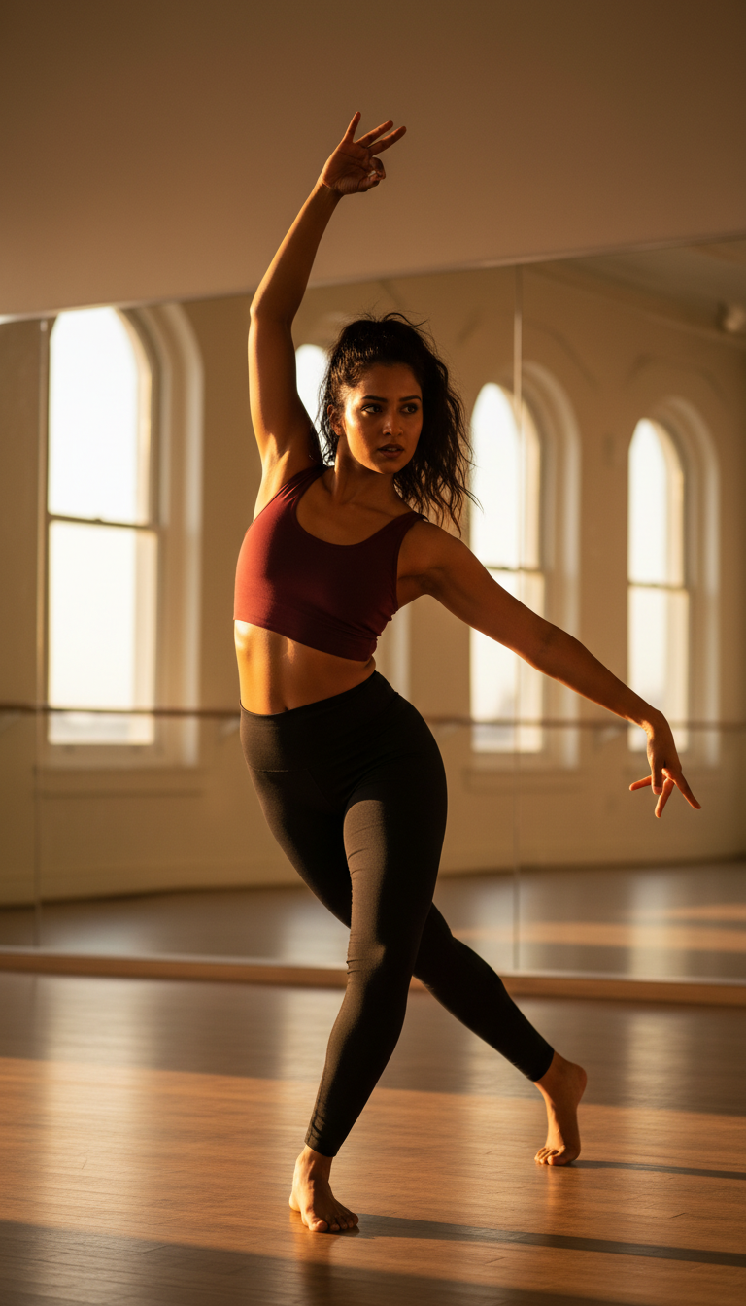
Learning the Craft
Golden hour rehearsals. Sweat and dedication.

Slide 13
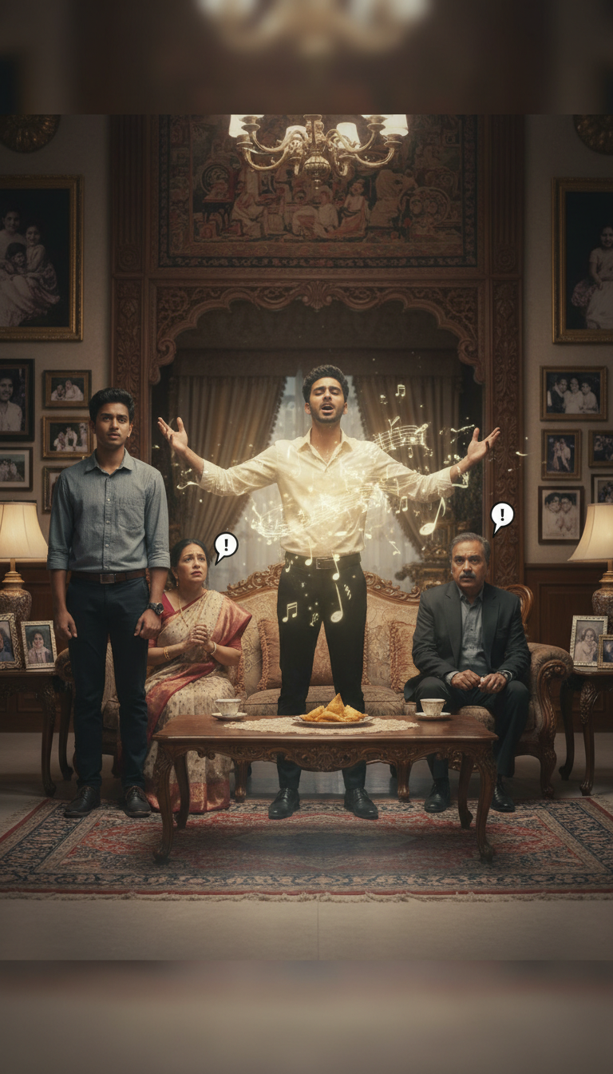
The Breaking Point
Family watches as their son chooses performance.

Slide 14
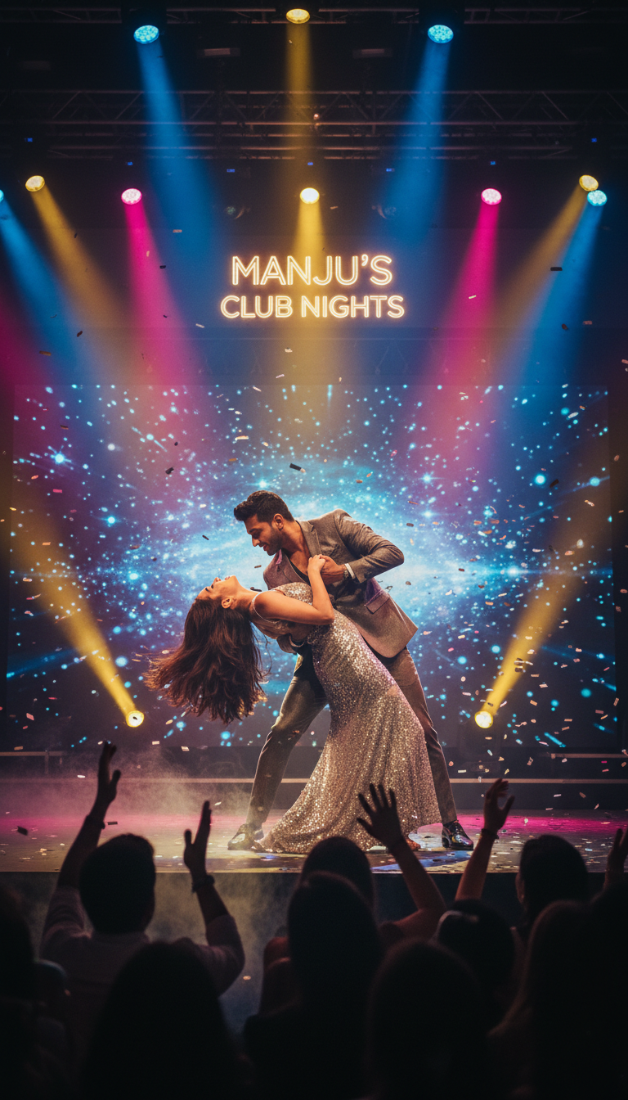
Manju's Club Nights
Real stage. Lights blazing. Confetti falls.

Slide 15
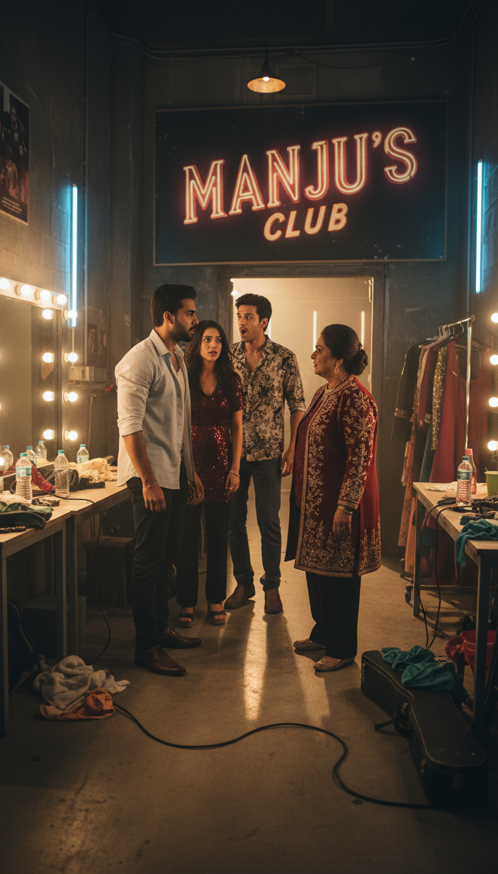
Manju's Club Nights
Real stage. Lights blazing. Confetti falls.

Slide 16
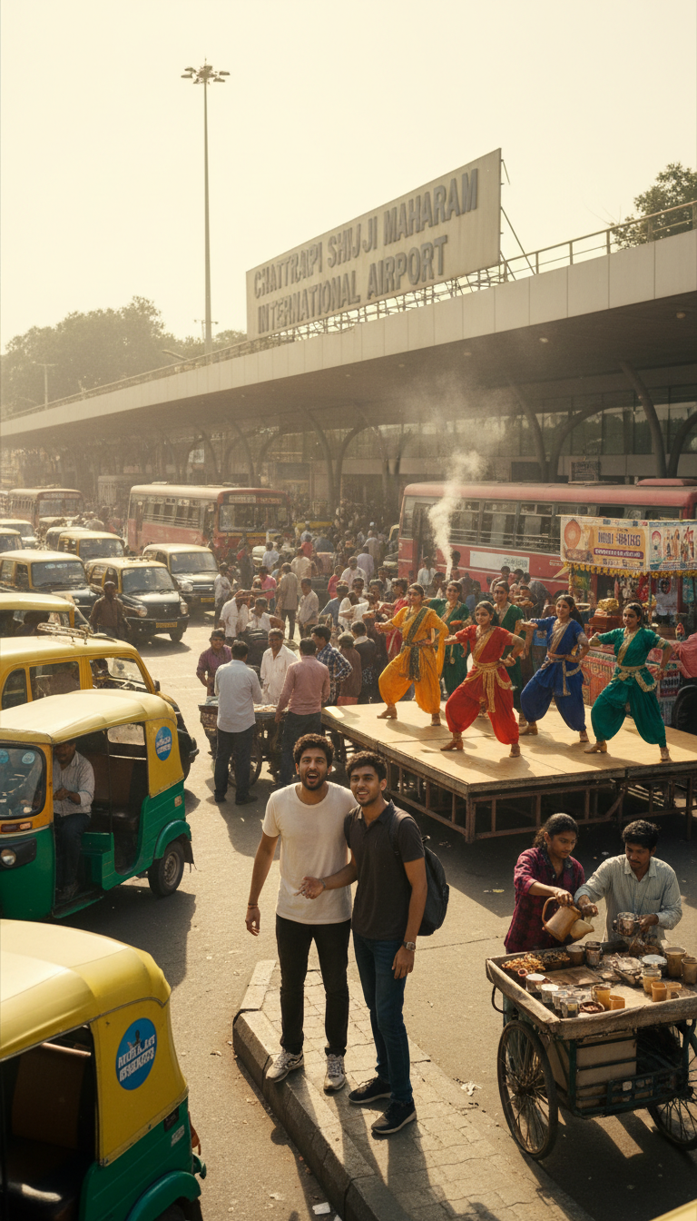
Mumbai Arrival
95° heat. Chaos. The dream made real.

Slide 17
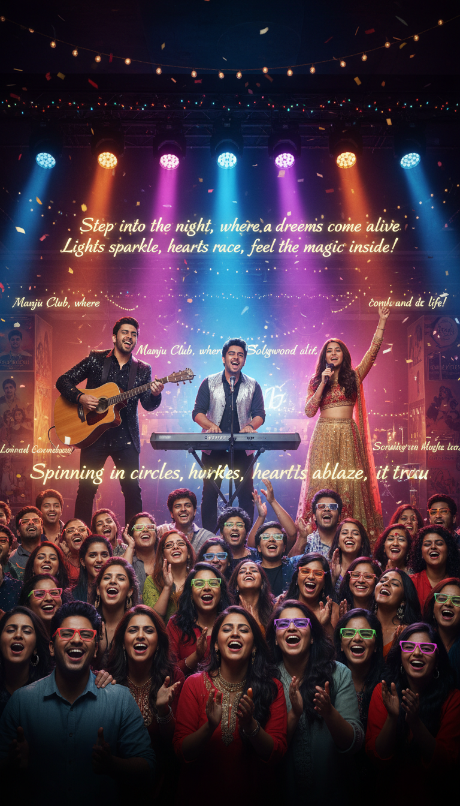
The Dream Begins
Grand theater. Chandeliers. Orchestra.

Slide 18
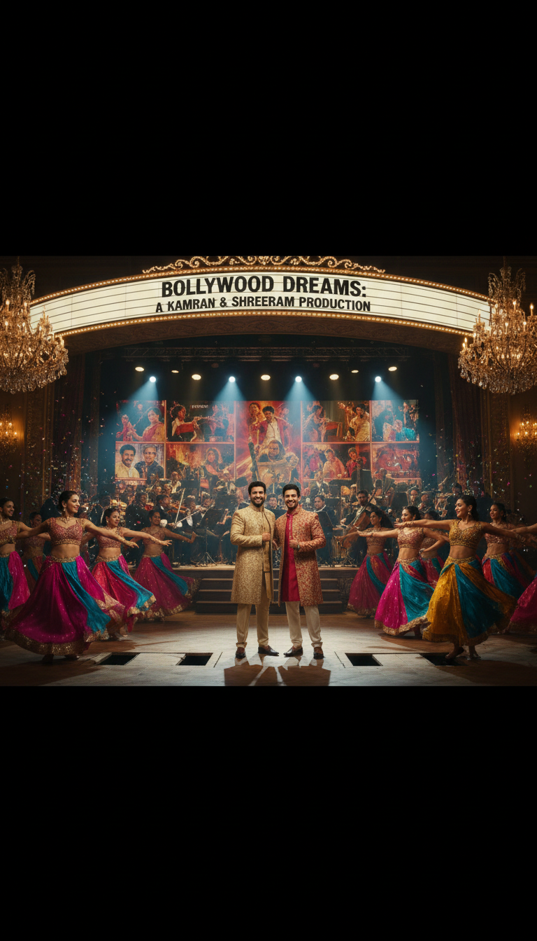
The Dream Begins
Grand theater. Chandeliers. Orchestra.

Slide 19
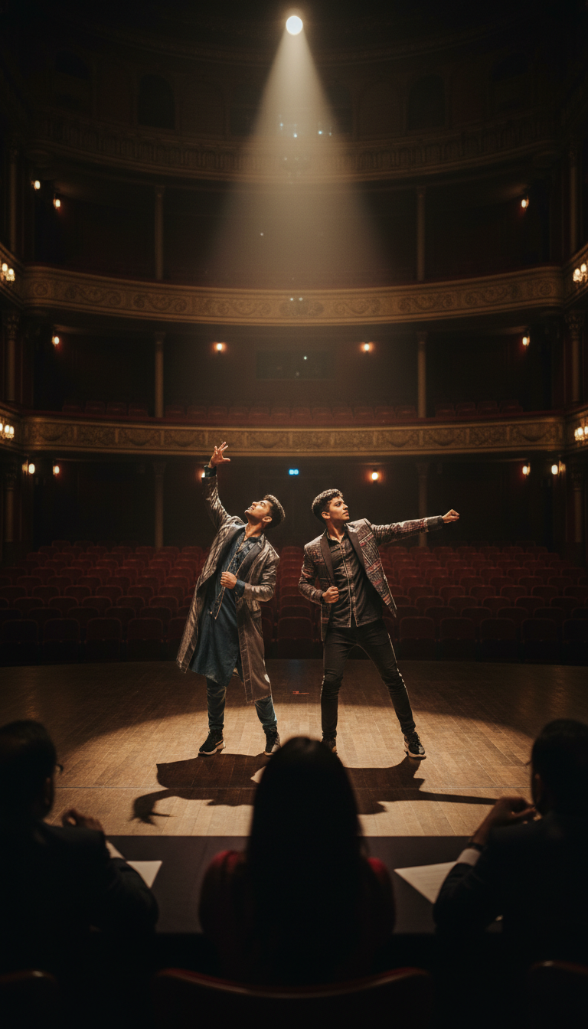
The Audition
Single spotlight. Everything on the line.

Slide 20
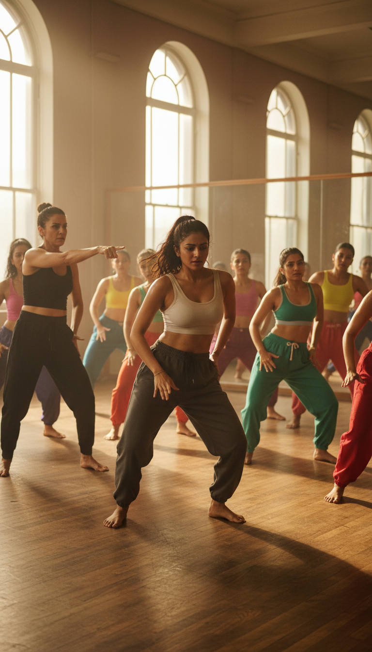
The Audition
Single spotlight. Everything on the line.

Slide 21
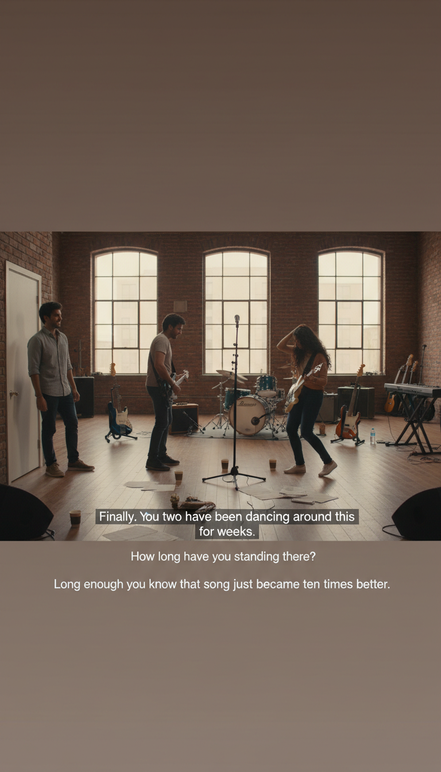
The Audition
Single spotlight. Everything on the line.

Slide 22
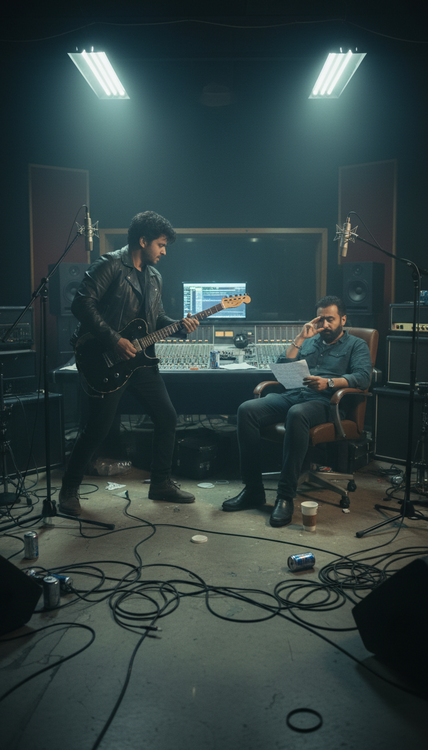
Recording Session
Late night. Creating music together.

Slide 23
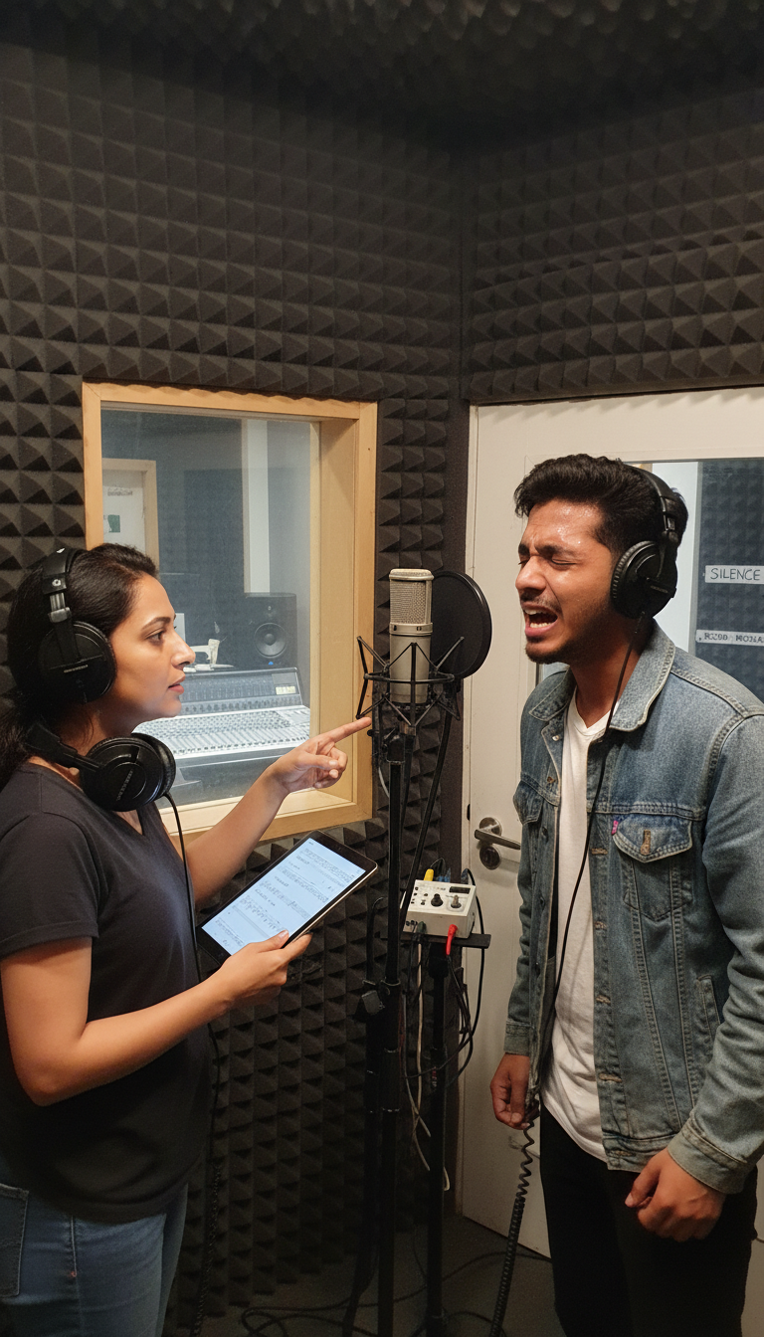
Recording Session
Late night. Creating music together.

Slide 24
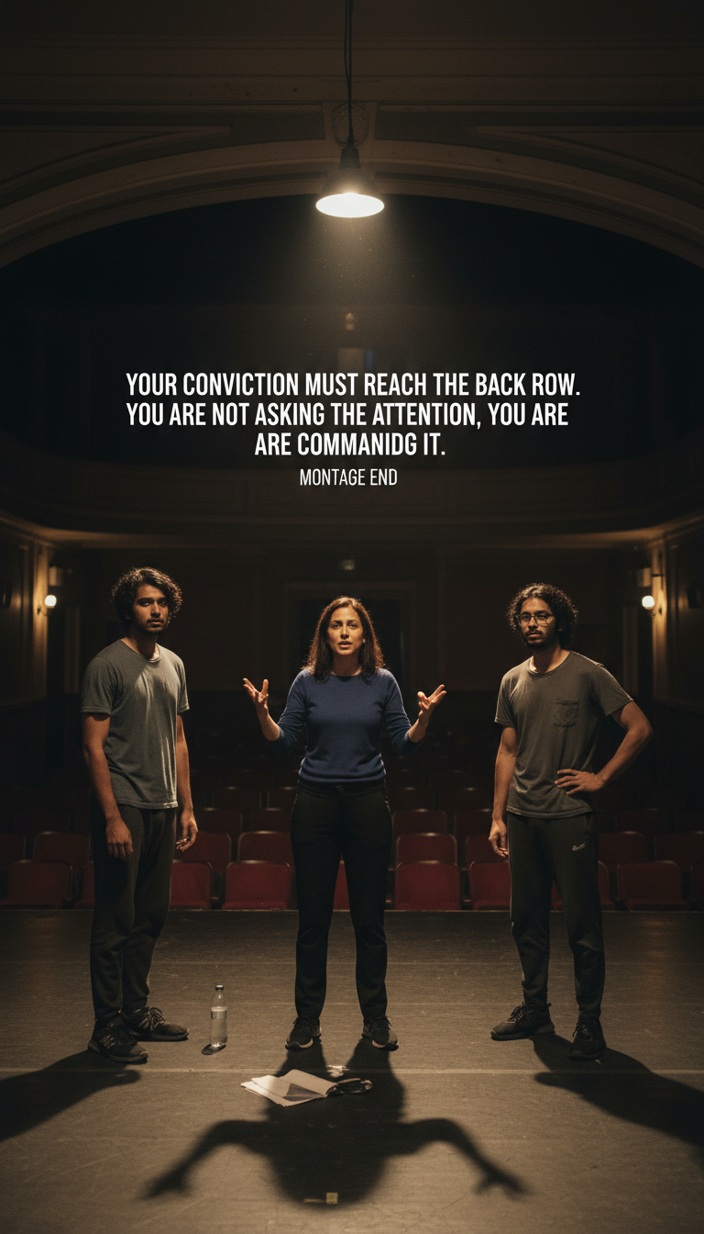
Professional Training
Bright lights. Mirrors. Perfectionism.

Slide 25
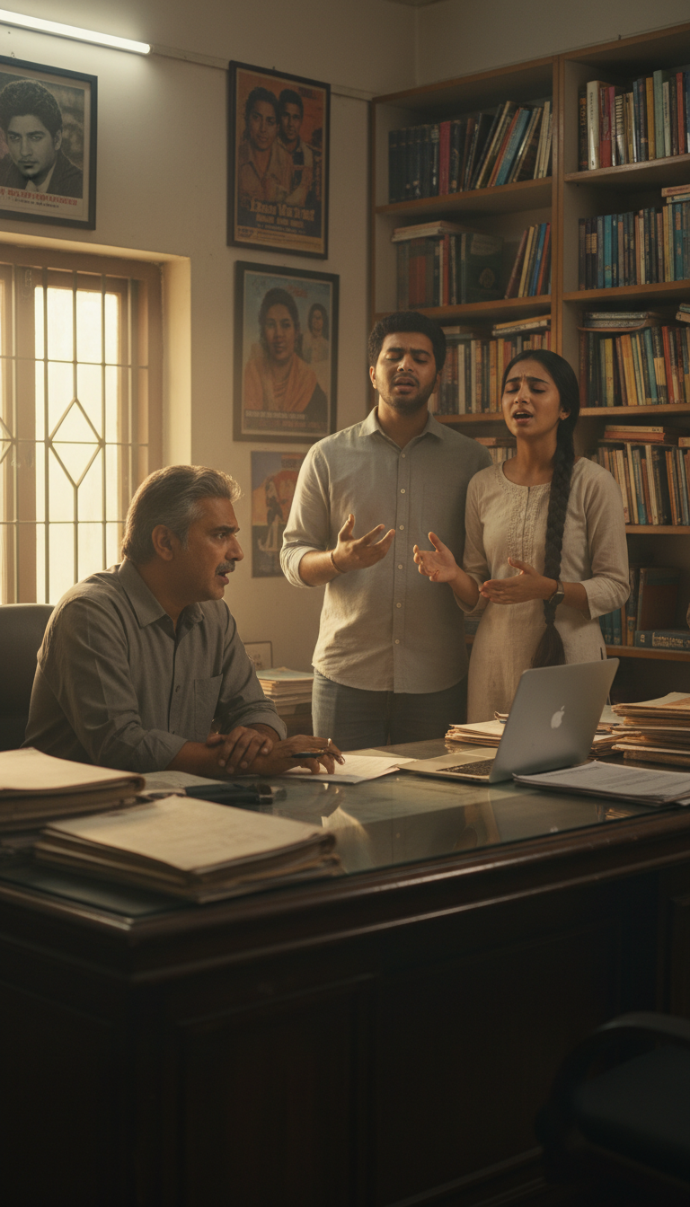
Professional Training
Bright lights. Mirrors. Perfectionism.

Slide 26
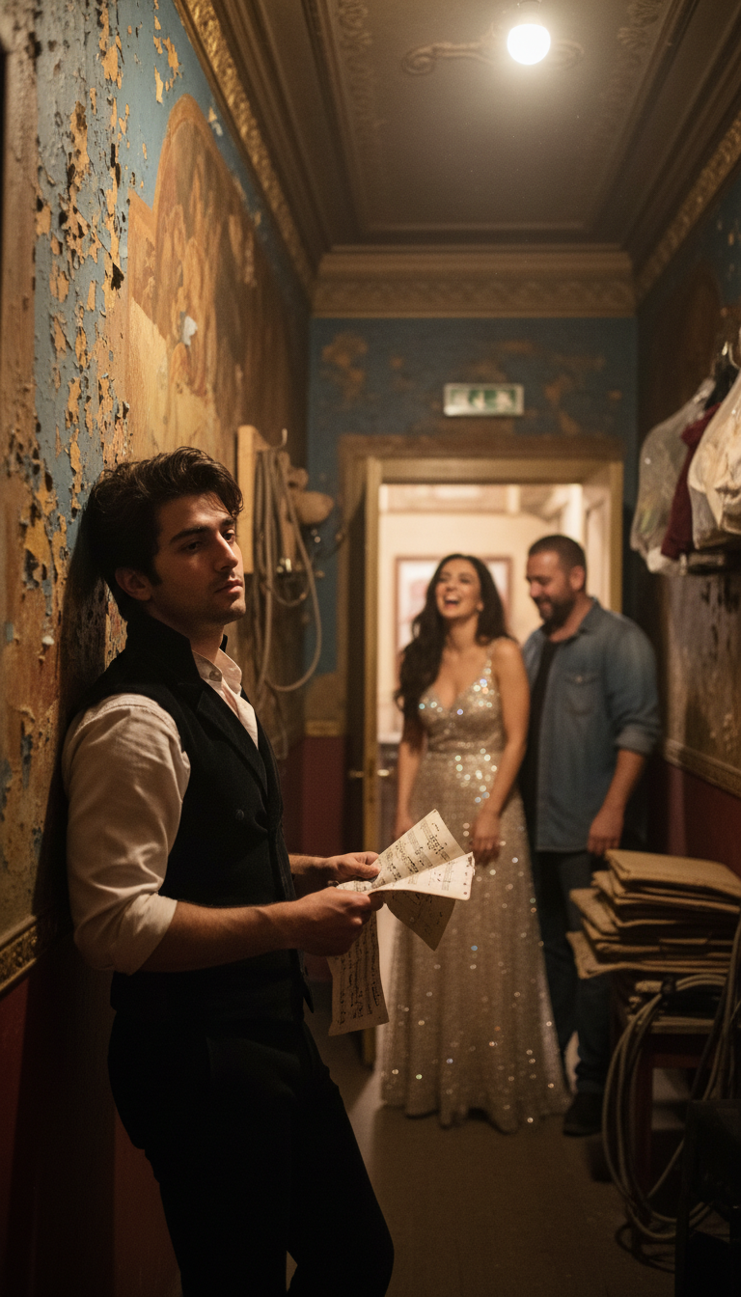
Meeting Priya
Backstage corridor. Chemistry ignites.

Slide 27
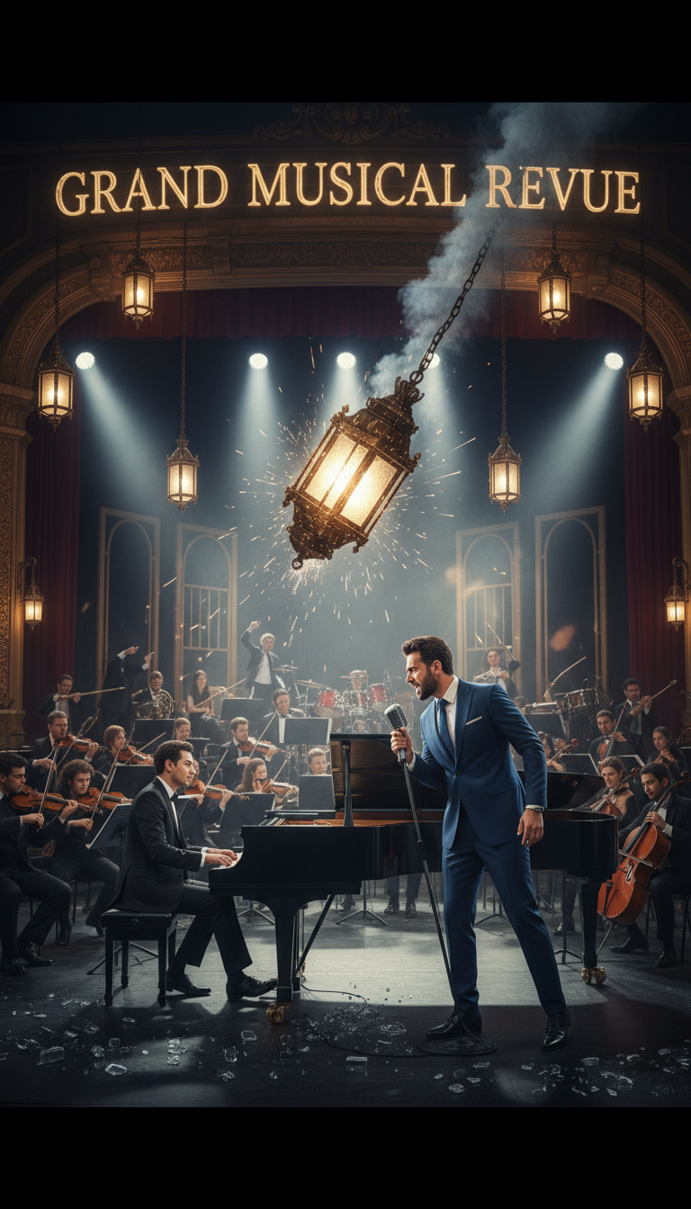
The Fantasy Peak
Impossible perfection. Everything they dreamed.

Slide 28
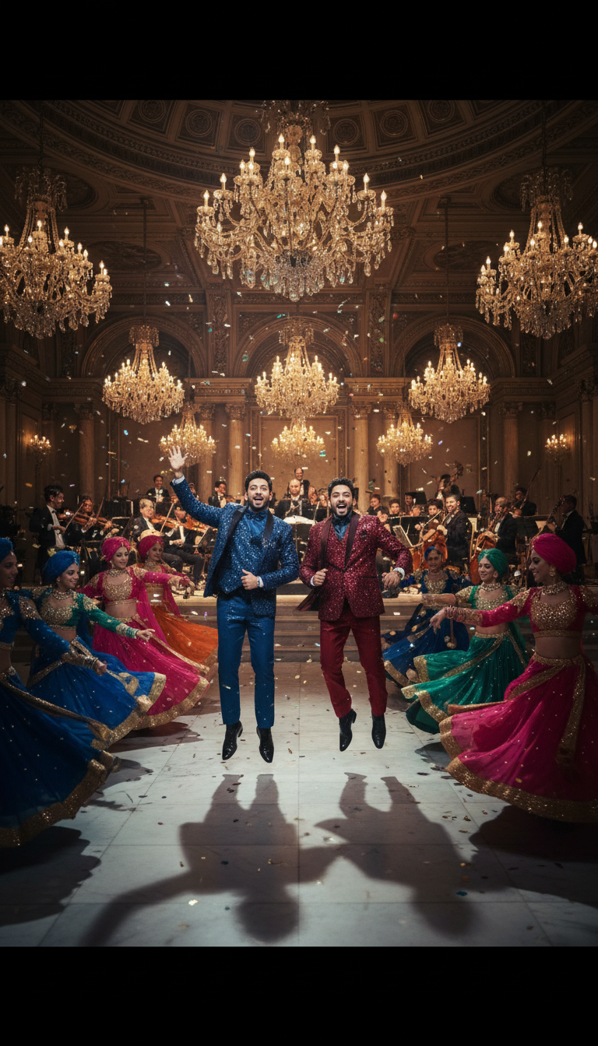
The Fantasy Peak
Impossible perfection. Everything they dreamed.

Slide 29
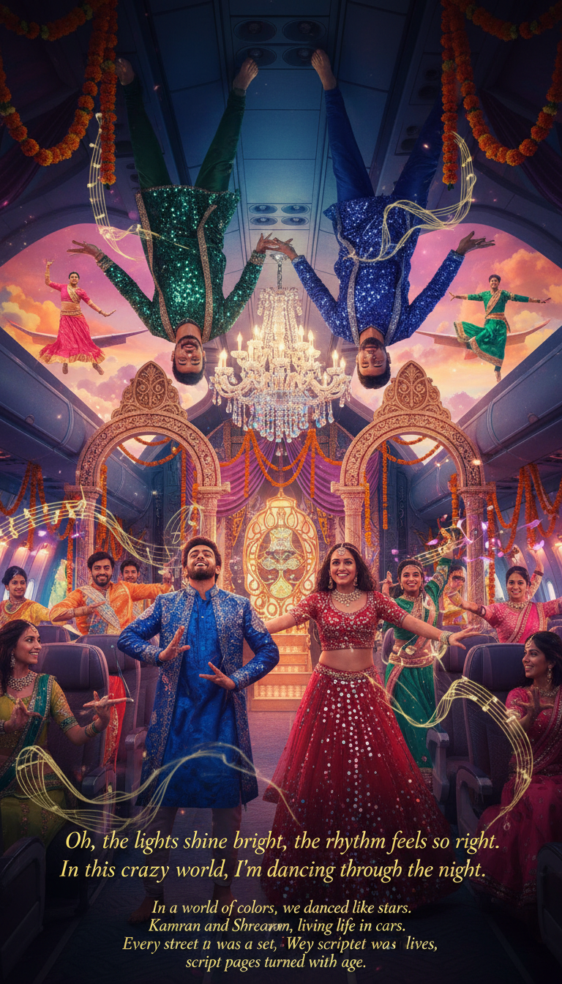
The Fantasy Peak
Impossible perfection. Everything they dreamed.

Slide 30
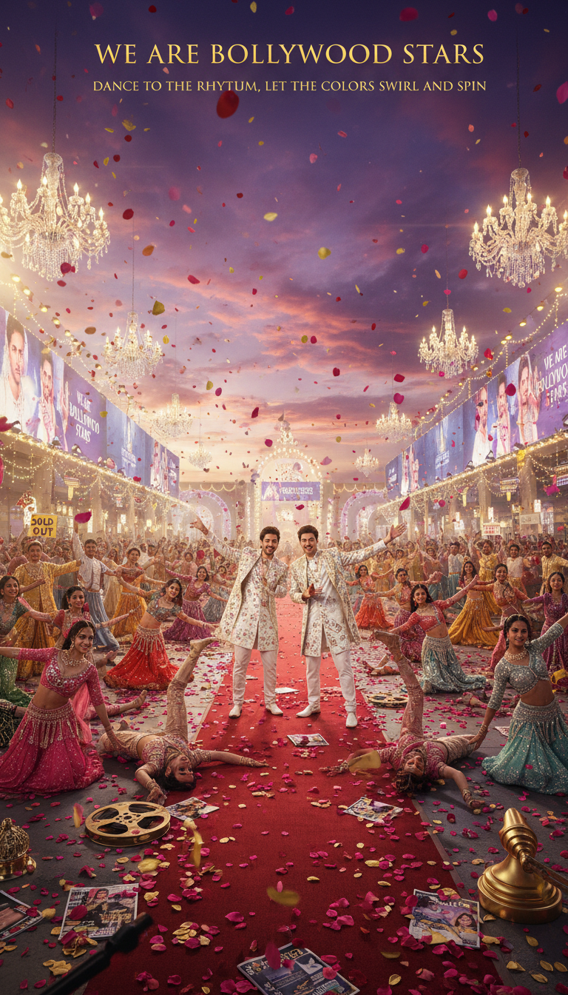
The Fantasy Peak
Impossible perfection. Everything they dreamed.

Slide 31
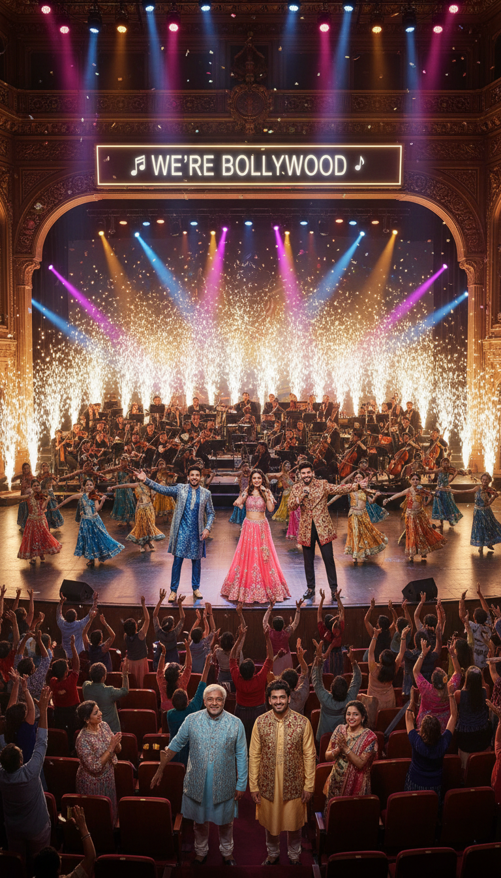
The Fantasy Peak
Impossible perfection. Everything they dreamed.

Slide 32
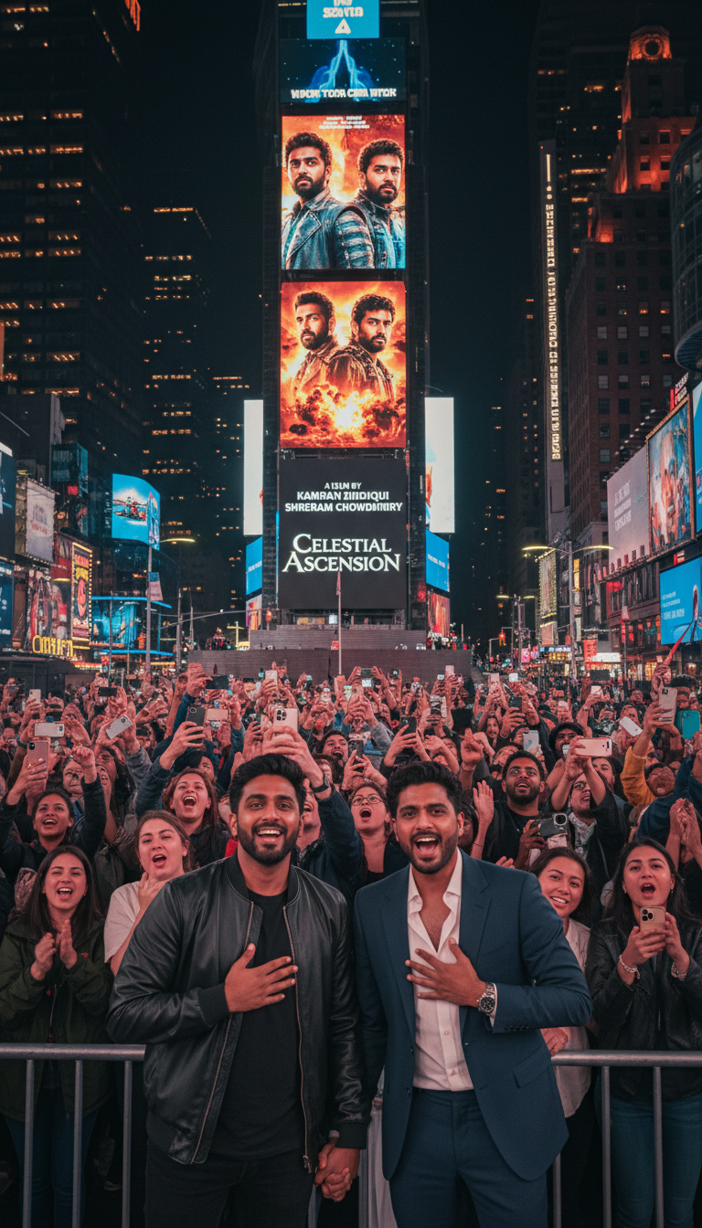
Times Square
Their names in lights. Broadway dreams.

Slide 33
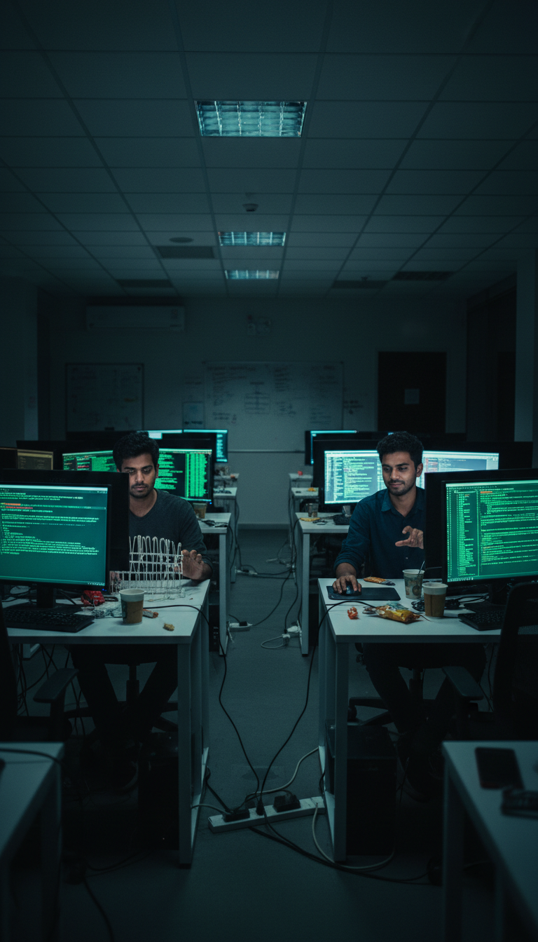
The Return
Grey cubicles again. Dream fades.

Slide 34
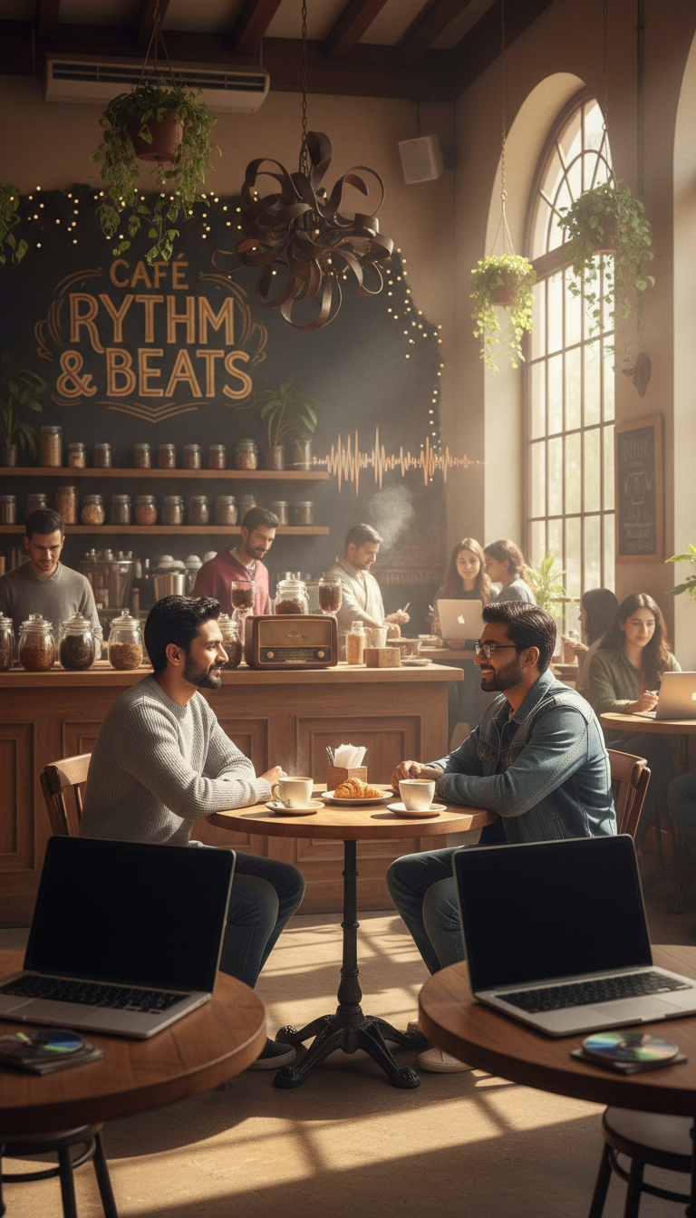
Café Rhythm & Beats
Coffee and revelation. Finding home.

Slide 35
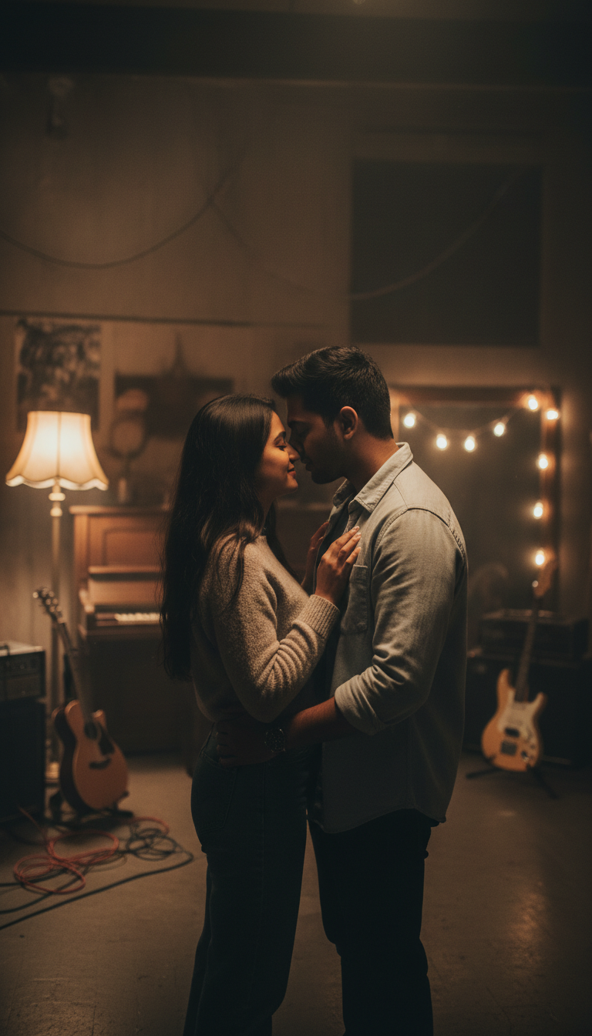
Creating Their Own Show
Late nights. Building something real.

Slide 36
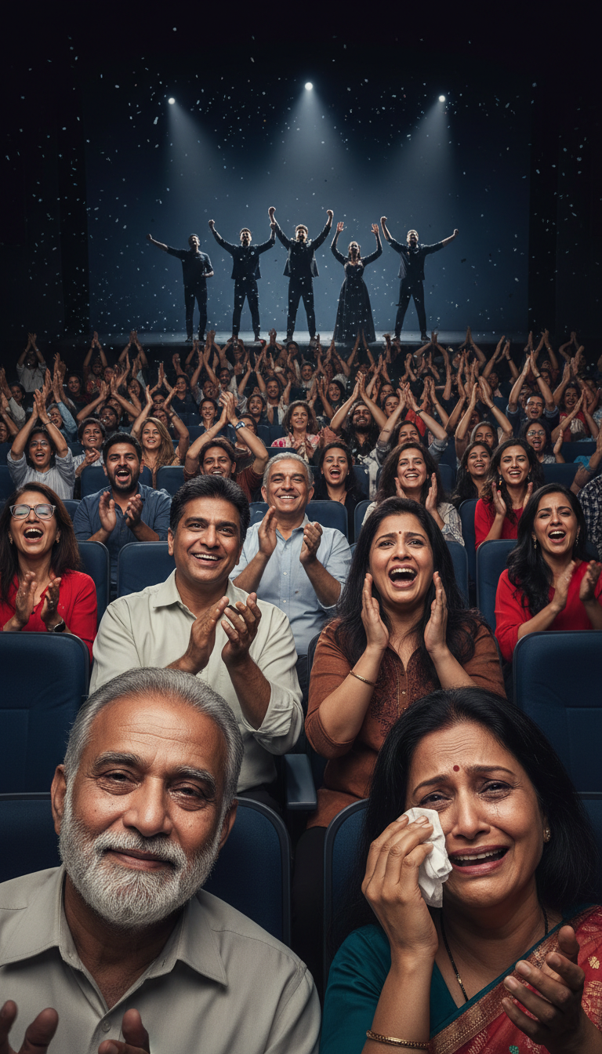
We Bring Our Whole Selves
Their truth on stage. Parents weeping with joy.

Slide 37
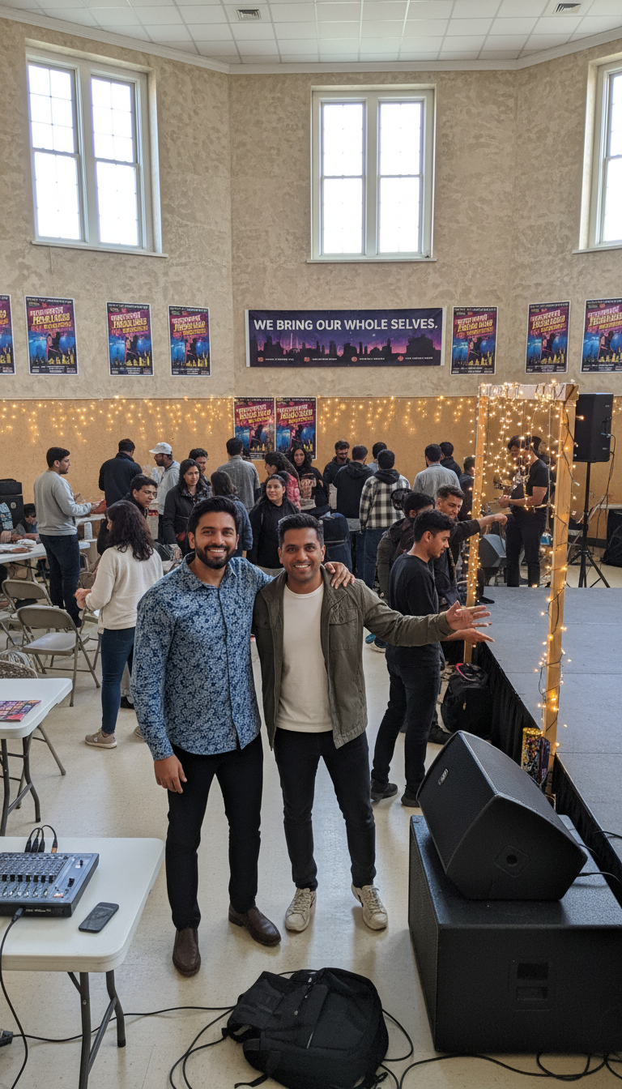
We Bring Our Whole Selves
Their truth on stage. Parents weeping with joy.

Slide 38
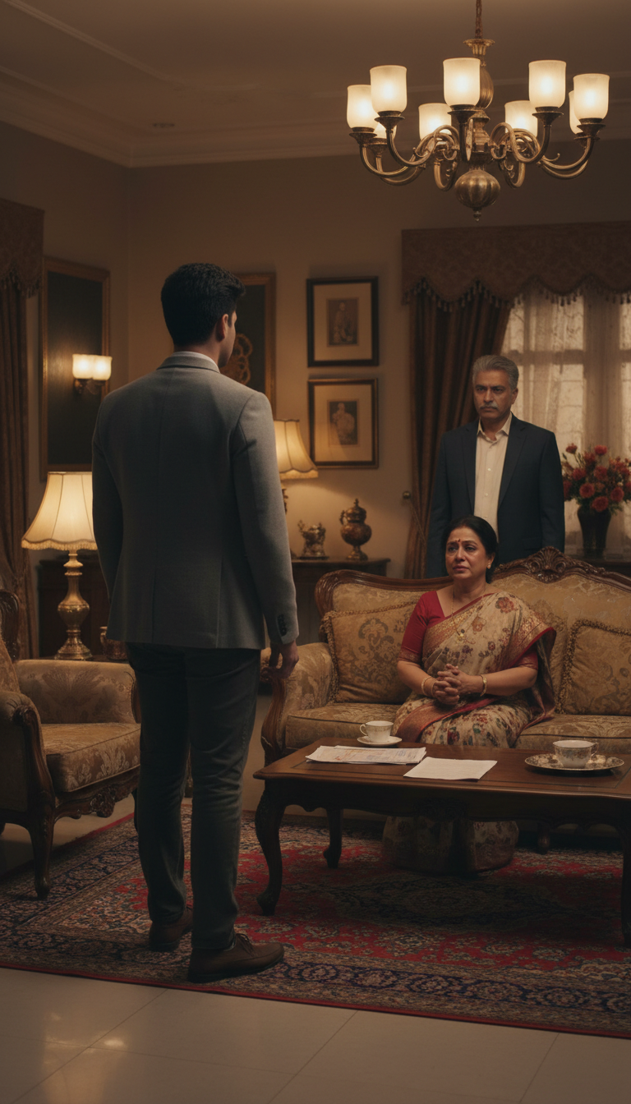
We Bring Our Whole Selves
Their truth on stage. Parents weeping with joy.

Slide 39
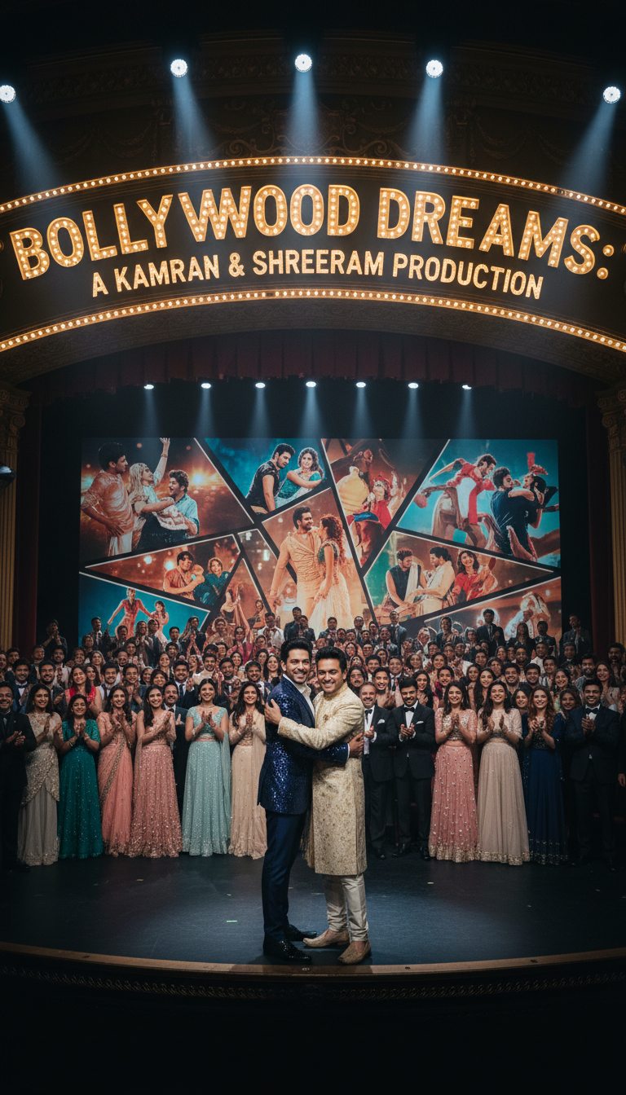
The Finale
Full company. Authentic triumph.

Slide 40
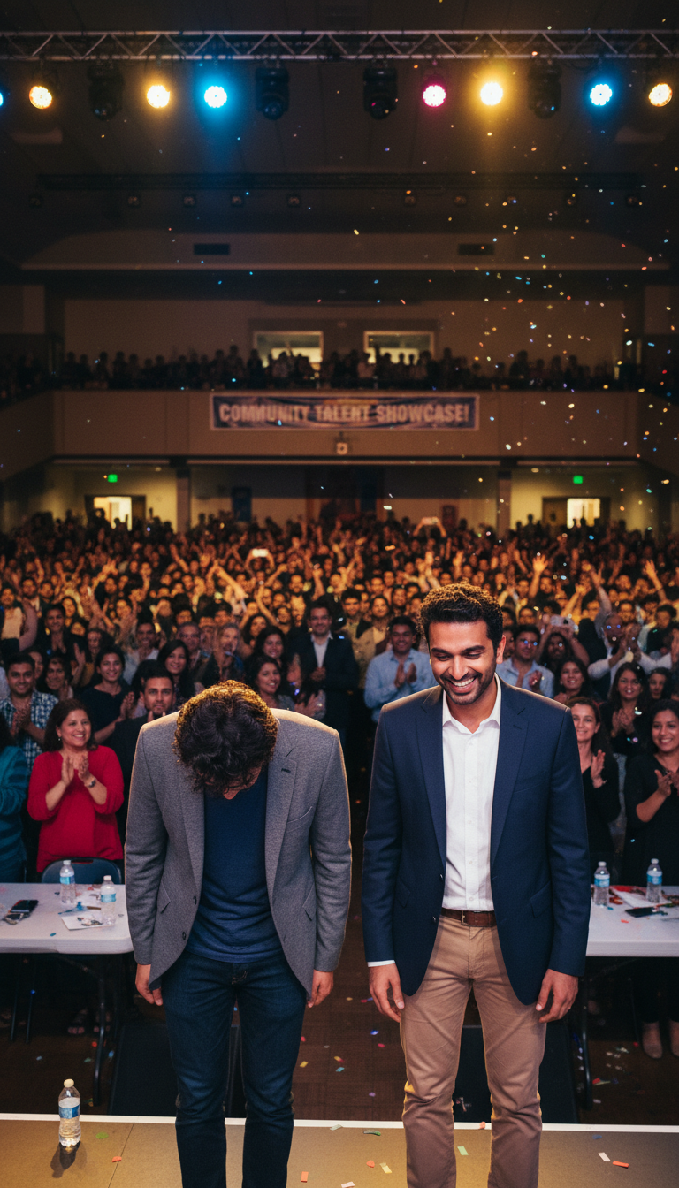
The Finale
Full company. Authentic triumph.

Slide 41
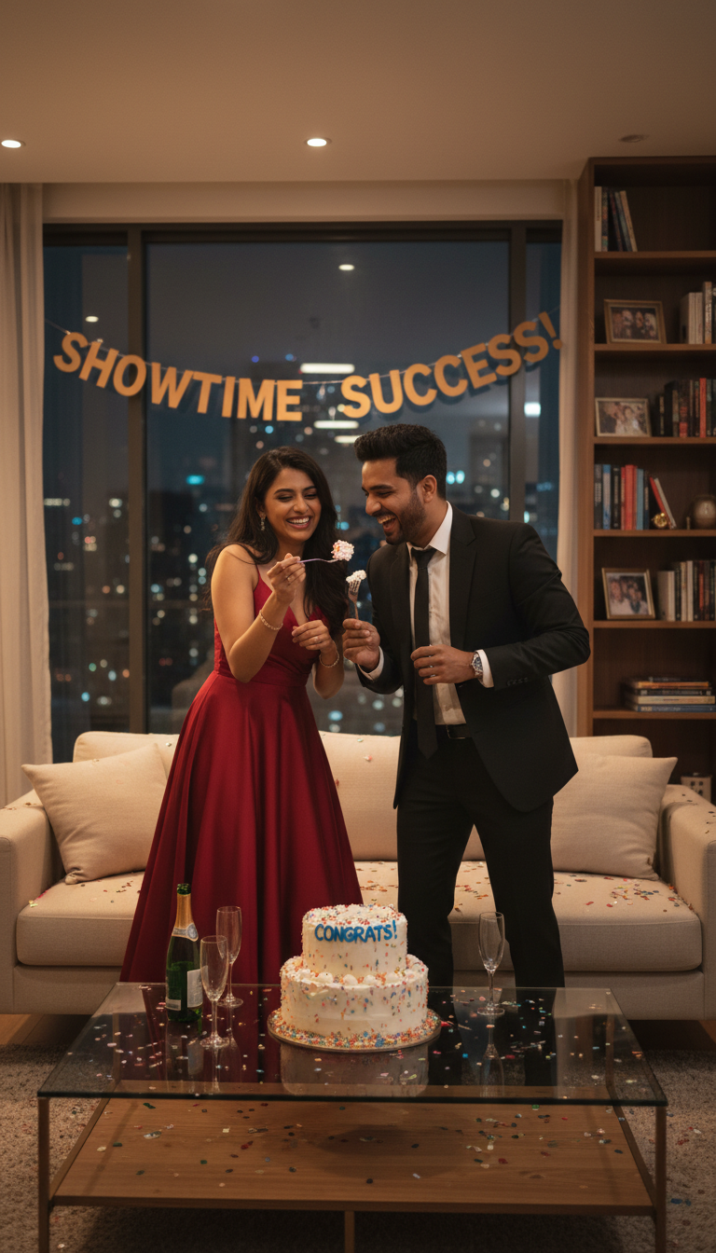
The Celebration
Freedom to create together. New beginnings.

Slide 42
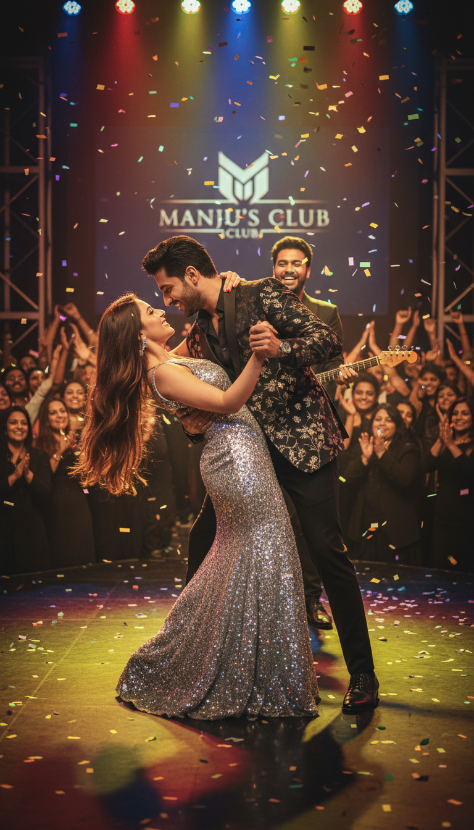
The Celebration
Freedom to create together. New beginnings.

Slide 43
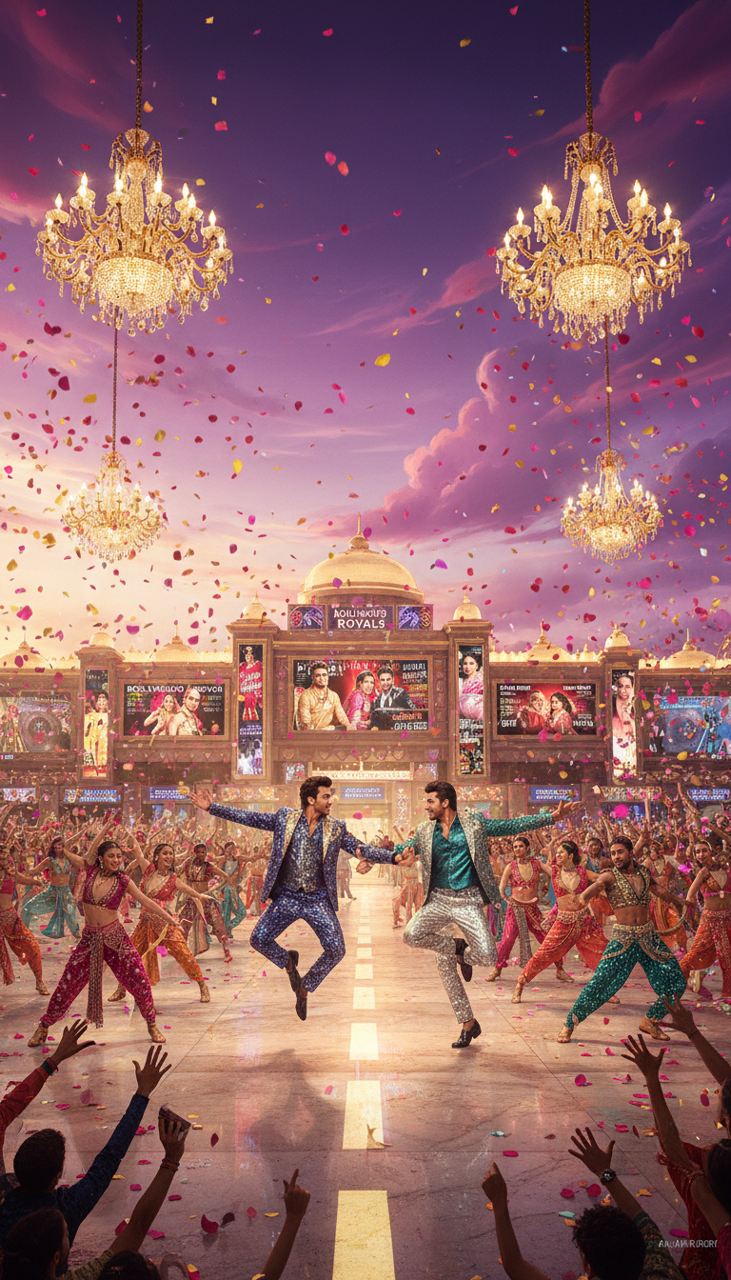
The Celebration
Freedom to create together. New beginnings.

Slide 44
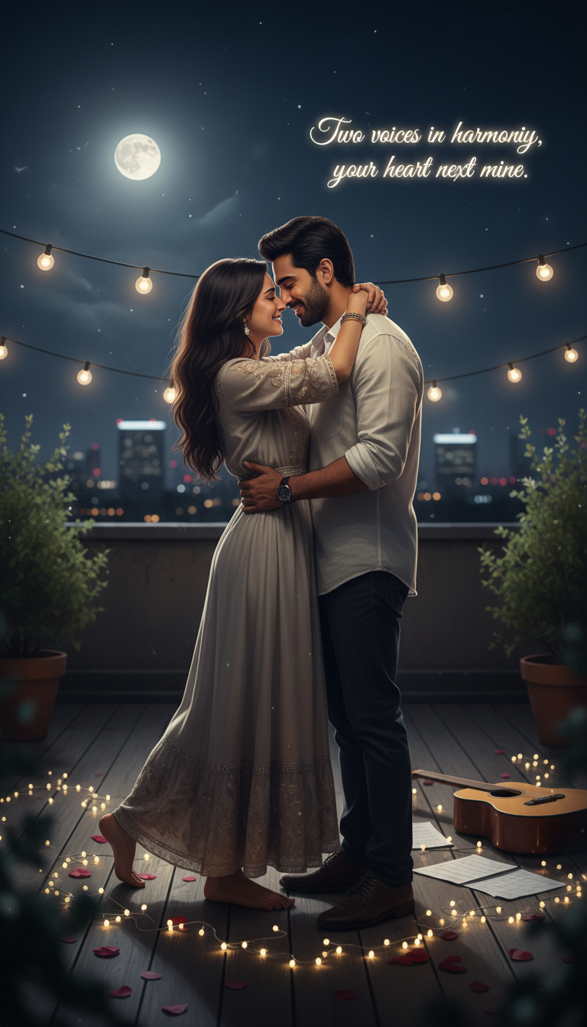
The Celebration
Freedom to create together. New beginnings.

Slide 45
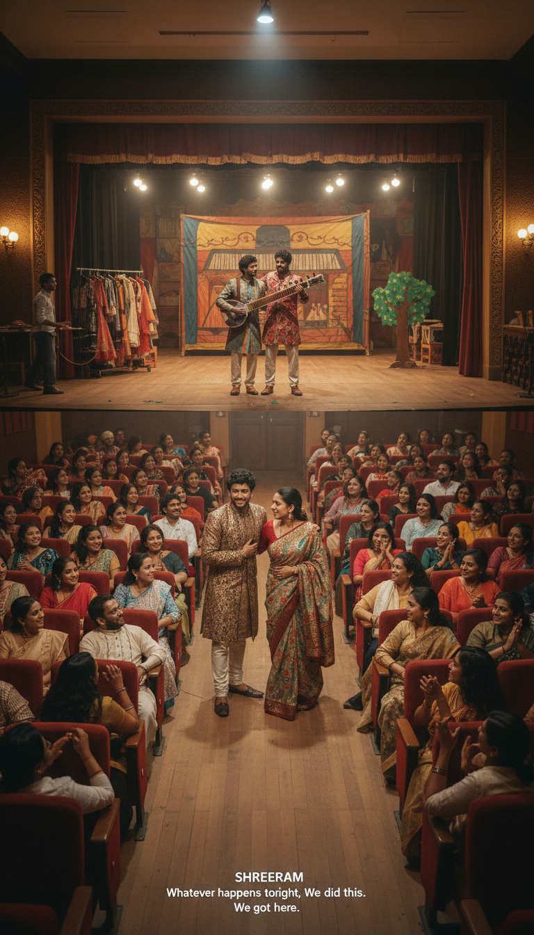
The Celebration
Freedom to create together. New beginnings.

Slide 46
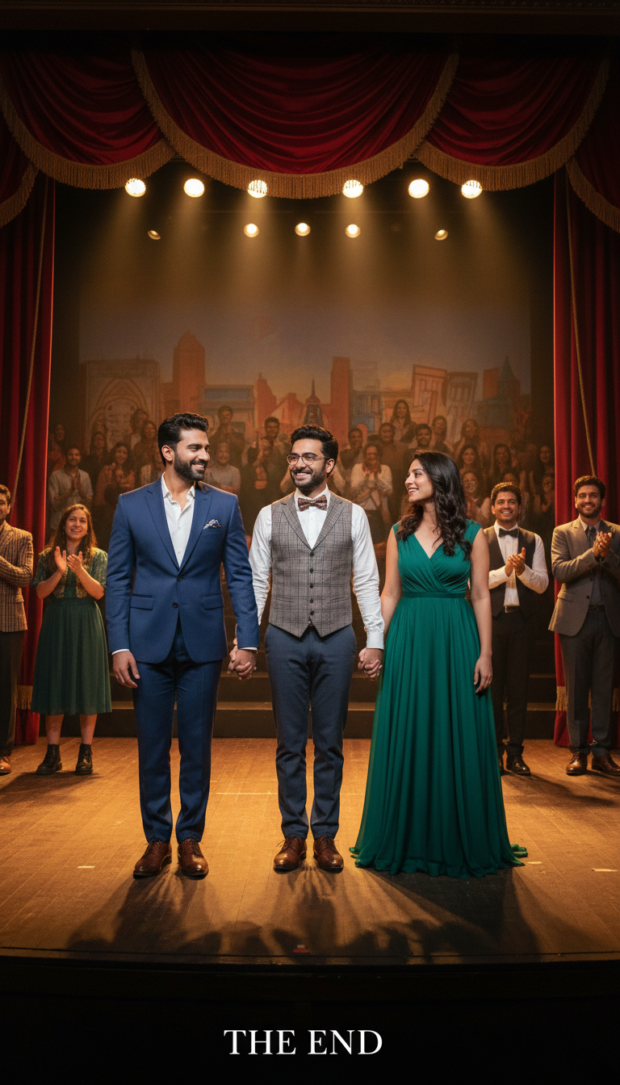
The Celebration
Freedom to create together. New beginnings.

Slide 47
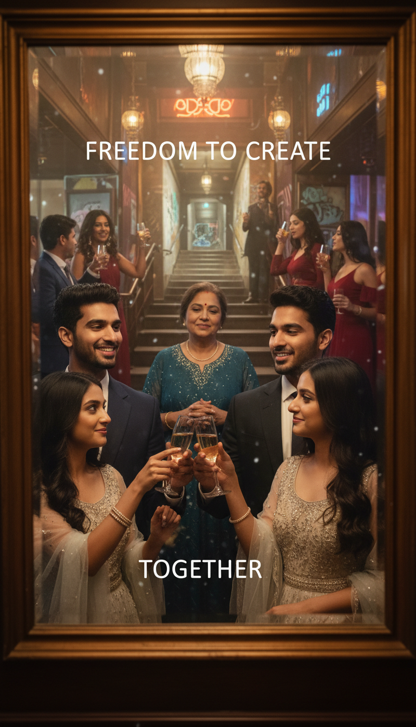
The Celebration
Freedom to create together. New beginnings.

